Slide 1
2023-24 NFhs basketball rules powerpoint
Rules Changes
Editorial Changes
Points of Emphasis

Slide 2
2023-24 NFHS Basketball
Rules Changes

Slide 3
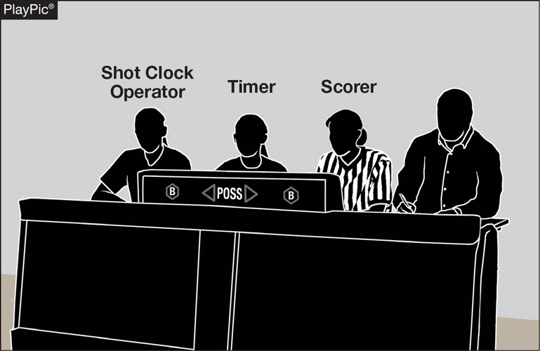
GAME AND TABLE OFFICIALS 2-1-3 NOTE
If utilizing a shot clock, the shot clock operator shall be located at the scorer’s and timer’s table.
This allows the officiating crew to quickly identify the person who is operating the shot clock should there be a timing issue that needs to be addressed.
Notes:
If utilizing a shot clock, the shot clock operator shall be located at the scorer’s and timer’s table.
Rationale: This allows the officiating crew to quickly identify the person who is operating the shot clock should there be a timing issue that needs to be addressed.

Slide 4
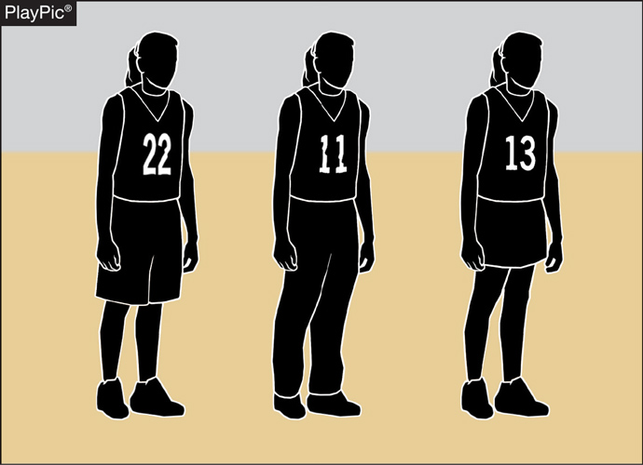
UNIFORMS 3-4-5
Teammates may wear multiple styles of uniform bottoms including shorts, skirts or pants, so long as they are like-colored.
Not all team members need to wear the same style.
However, all styles must meet uniform requirements for visible manufacturer logos and trademarks.
Notes:
Teammates may wear multiple styles of uniform bottoms including shorts, skirts or pants, so long as they are like-colored.
Not all team members need to wear the same style.
However, all styles must meet uniform requirements for visible manufacturer logos and trademarks
Rationale: Clarifies that teammates must all wear like-colored uniform bottoms but may wear multiple styles while aligning language with other NFHS rules codes.

Slide 5
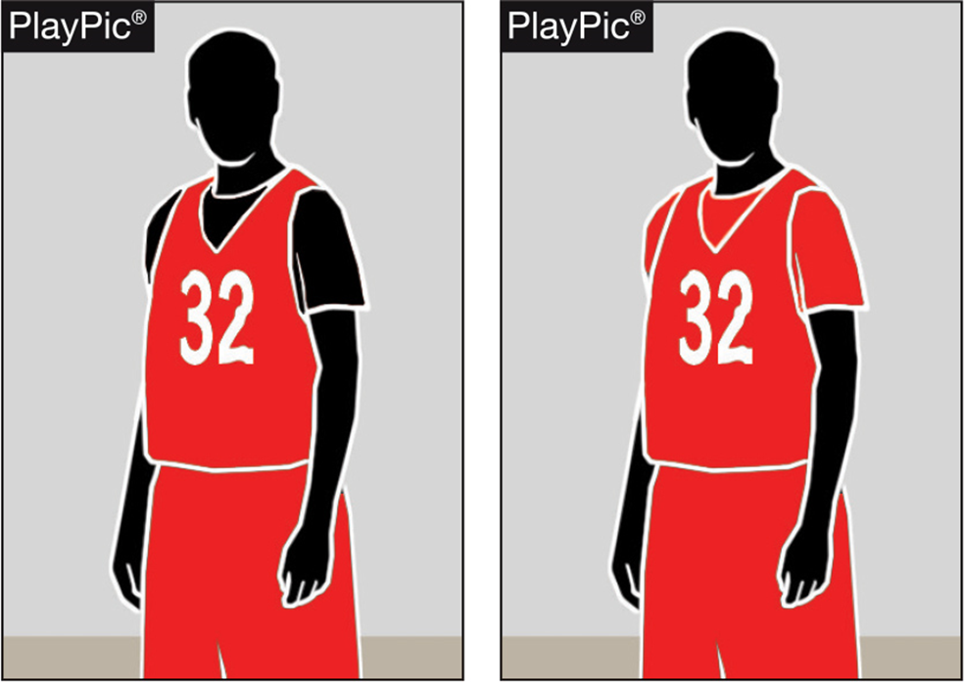
Team Member’s Equipment, Apparel 3-5-6
If the visiting team is wearing undershirts with their dark jerseys, the undershirts may now be a single solid color similar to the torso of the jersey or solid black.
Notes:
If the visiting team is wearing undershirts with their dark jerseys, the undershirts may now be a single solid color similar to the torso of the jersey or solid black.
Rationale: Allows schools with hard-to-find colors to wear black under visiting team jerseys while continuing to require all team members to match.

Slide 6
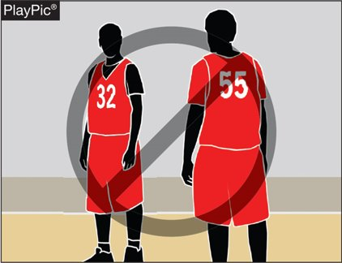
Team Member’s Equipment, Apparel 3-5-6
Team members in this PlayPic may wear either solid black or solid red undershirts, but players on the same team cannot wear both.
If players choose to wear an undershirt, all undershirts must be the same color.
Notes:
Team members in this PlayPic may wear either solid black or solid red undershirts, but players on the same team cannot wear both.
If players choose to wear an undershirt, all undershirts must be the same color.

Slide 7
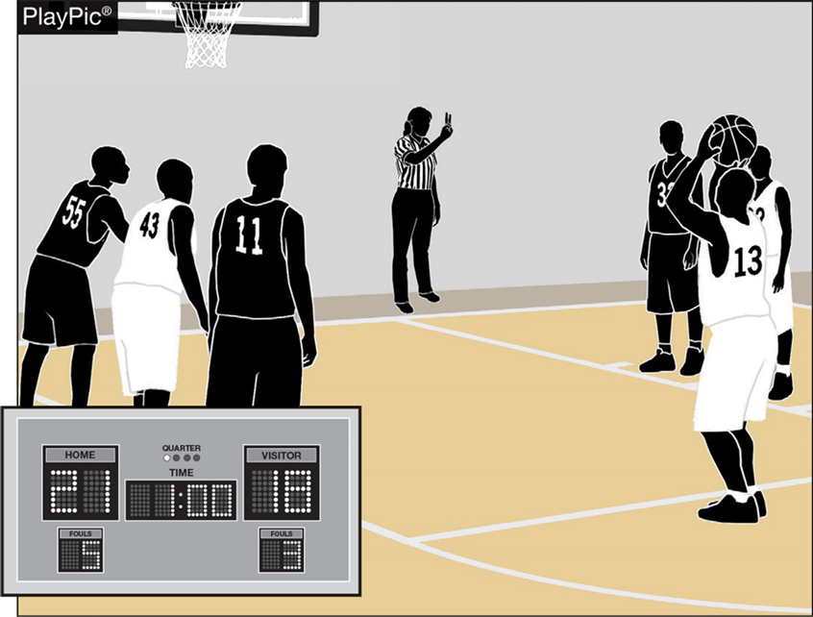
BONUS FREE THROWS 4-8-1
Two free throws will now be awarded for all common fouls, except for a player-control foul or team-control foul, beginning with the fifth team foul in each quarter.
Team fouls will be reset to zero at the end of each quarter, excluding the fourth quarter if an overtime period is needed.
Notes:
Two free throws will now be awarded for all common fouls, except for a player-control foul or team-control foul, beginning with the fifth team foul in each quarter.
Team fouls will be reset to zero at the end of each quarter, excluding the fourth quarter if an overtime period is needed.
Rationale: Improves flow by providing an opportunity for teams to adjust their play by not carrying over fouls from quarters 1 and 3 to quarters 2 and 4 while significantly reducing the opportunity for correctable errors to occur. Minimizes risk of injury by eliminating the one-and-one and reducing opportunities for rough play during rebounding opportunities.

Slide 8
Resumption of play procedure, throw-ins 7-5-2 thru 4 (NEW)
After an out of bounds violation in either the frontcourt or the backcourt by either team, the throw-in shall be at the designated spot nearest to where the ball went out of bounds.
Notes:
After an out of bounds violation in either the frontcourt or the backcourt by either team, the throw-in shall be at the designated spot nearest to where the ball went out of bounds.

Slide 9
Resumption of play procedure, throw-ins 7-5-2 thru 4 (NEW)
After a violation or a foul before the bonus is in effect by either team or any other stoppage in play, the throw-in location will be determined by the location of the violation/foul or the location of the ball when the stoppage occurs:
Frontcourt throw-in – one of the newly established four designated spots (28-foot mark along each sideline or 3-feet outside the lane line along the end line).
Backcourt throw-in – the designated spot nearest the foul, violation or other stoppage.
Notes:
After a violation or a foul before the bonus is in effect by either team or any other stoppage in play, the throw-in location will be determined by the location of the violation/foul or the location of the ball when the stoppage occurs:
Frontcourt throw-in – one of the newly established four designated spots (28-foot mark along each sideline or 3-feet outside the lane line along the end line).
Backcourt throw-in – the designated spot nearest the foul, violation or other stoppage.
Rationale: Simplifies throw-in procedure when a team gains or retains possession for situations other than an out-of-bounds throw-in.

Slide 10
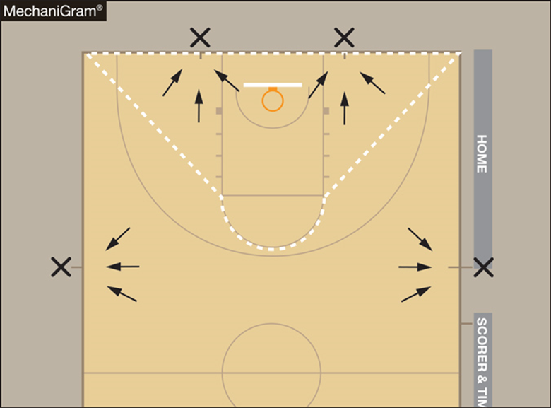
Resumption of play procedure, throw-ins [7-5-2 thru 4 (NEW)]
Frontcourt throw-ins – Officials shall determine the throw-in spot by using an imaginary line (dotted line).
If the stoppage of play occurs inside the dotted imaginary line, the spot shall be the nearest point on the end line 3-feet outside the lane line.
If the stoppage of play occurs outside the dotted imaginary line, the spot shall be the nearest 28-foot mark along each sideline.
NOTE: Court markings are not required.
Notes:
Frontcourt throw-ins – Officials shall determine the throw-in spot by using an imaginary line (dotted line).
If the stoppage of play occurs inside the dotted imaginary line, the spot shall be the nearest point on the end line 3-feet outside the lane line.
If the stoppage of play occurs outside the dotted imaginary line, the spot shall be the nearest 28-foot mark along each sideline.
NOTE: Court markings are not required.

Slide 11
Throw-in administration 7-6-6
When an official administers a throw-in to the wrong team, the officials may now rectify the mistake at any time before the first dead ball after the ball becomes live unless there is a change in possession.
After the ball becomes dead or the correct team gains possession, the time to correct the mistake has expired.
Notes:
When an official administers a throw-in to the wrong team, the officials may now rectify the mistake at any time before the first dead ball after the ball becomes live unless there is a change in possession.
After the ball becomes dead or the correct team gains possession, the time to correct the mistake has expired.
Rationale: Allows for a correction of an official's mistake in a more reasonable timeframe.

Slide 12
Out of BOUNDS 9-3-3
Legal
Illegal
A player may now step out of bounds as long as the player is not the first player to touch the ball, or the player did not step out of bounds to avoid a violation (MechaniGram A).
Any player who steps out of bounds under the player’s own volition and is the first player to touch the ball after returning to the playing court or does so to avoid a violation has committed a violation (MechaniGram B).
Notes:
A player may now step out of bounds as long as the player is not the first player to touch the ball, or the player did not step out of bounds to avoid a violation (MechaniGram A).
Any player who steps out of bounds under the player’s own volition and is the first player to touch the ball after returning to the playing court or does so to avoid a violation has committed a violation (MechaniGram B).
Rationale: Allows a player to step out of bounds if they gain no advantage and penalizes a team only if they gain an advantage by leaving the court and returning to avoid a violation or to be the first to touch the ball.

Slide 13
2023-24 NFHS Basketball
Editorial Changes

Slide 14
GAME AND TABLE OFFICIALS 2-1-1
The official’s uniform shall be a black-and-white striped shirt, black pants, predominantly black shoes and black socks.
Rationale: A change from the word “primarily” to “predominantly” allows official more footwear options.
Notes:
The official’s uniform shall be a black-and-white striped shirt, black pants, predominantly black shoes and black socks.
Rationale: A change from the word “primarily” to “predominantly” allows official more footwear options.

Slide 15
Setting Direction of Initial arrow 4-3-2
Alternating-possession control is established, and the initial direction of the possession arrow is set toward the opponent’s basket when:
ART. 2 . . . Entering an overtime period, the ball is placed at the disposal of the free thrower after a common foul when the bonus free throws are in effect.
Rationale: Clarifies that the possession arrow is set towards the opponent’s basket when the ball is placed at the disposal of the free thrower after a common foul when the bonus rule is in effect, which can only occur, entering an overtime period.
Notes:
Alternating-possession control is established, and the initial direction of the possession arrow is set toward the opponent’s basket when:
ART. 2 . . . Entering an overtime period, the ball is placed at the disposal of the free thrower after a common foul when the bonus free throws are in effect.
Rationale: Clarifies that the possession arrow is set towards the opponent’s basket when the ball is placed at the disposal of the free thrower after a common foul when the bonus rule is in effect, which can only occur, entering an overtime period.

Slide 16
Foul 4-19-13
ART. 13 . . . A team foul is any personal foul or technical foul (except indirect technical fouls) which is charged to either team. All team fouls are counted to reach the bonus free throws for the quarter in which they are assessed.
Rationale: Clarifies that team fouls are only counted towards the bonus in the quarter in which they were assessed.
Notes:
ART. 13 . . . A team foul is any personal foul or technical foul (except indirect technical fouls) which is charged to either team. All team fouls are counted to reach the bonus free throws for the quarter in which they are assessed.
Rationale: Clarifies that team fouls are only counted towards the bonus in the quarter in which they were assessed.

Slide 17
Shot clock Guidelines
THE SHOT CLOCK OPERATOR SHALL:
6. Stop the timing device and reset to full amount:
b. When any of the following occurs:
ii: A single technical foul assessed to the defensive team.
v: A violation, and the defense is awarded the ball for a throw-in.
Rationale: All technical fouls per NFHS Rule 10 Penalty result in a change of possession, two free throws and the ball at the division line (unless simultaneous offsetting), therefore a full shot clock reset would occur.
A violation by the defense, such as a kicked ball, will result in a full reset to the offensive team and a violation by the offense will result in a turnover and thus a full reset.
Notes:
Editorial Changes to the guidelines include:
THE SHOT CLOCK OPERATOR SHALL:
6. Stop the timing device and reset to full amount:
b. When any of the following occurs:
ii: A single technical foul assessed to the defensive team.
v: A violation, and the defense is awarded the ball for a throw-in.
Rationale: All technical fouls per NFHS Rule 10 Penalty result in a change of possession, two free throws and the ball at the division line (unless simultaneous offsetting), therefore a full shot clock reset would occur.
A violation by the defense, such as a kicked ball, will result in a full reset to the offensive team and a violation by the offense will result in a turnover and thus a full reset.

Slide 18
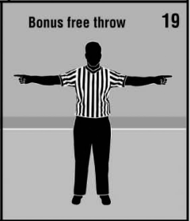
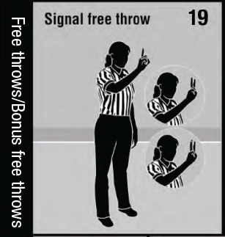
Official NFHS Basketball Signals
Officials Signal #7 – Clarified description to include throw-in violation.
Officials Signal #19 – Removed “Bonus free throw” signal and included “Bonus free throws” in title of new #19 “Signal free throw.”
Notes:
Officials Signal #7 – Clarified description to include throw-in violation.
Officials Signal #19 – Removed “Bonus free throw” signal and included “Bonus free throws” in title of new #19 “Signal free throw.”

Slide 19
2023-24 NFHS Basketball
Points of Emphasis

Slide 20
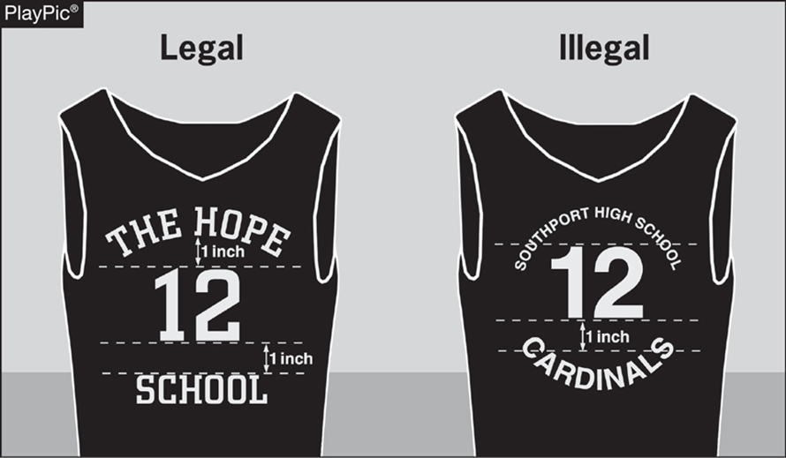
Uniforms, Equipment and apparel
Coaches and school administrators must ensure that legal uniforms are being ordered and purchased from manufacturers/distributors.
If in doubt, prior to purchasing uniforms, equipment or apparel, confirm legality with the local state association.
An NFHS basketball uniform guide was created to illustrate the proper uniform design. That document and an animated presentation can be found on the NFHS website.
Notes:
Coaches and school administrators must ensure that legal uniforms are being ordered and purchased from manufacturers/distributors.
If in doubt, prior to purchasing uniforms, equipment or apparel, confirm legality with the local state association.
An NFHS basketball uniform guide was created to illustrate the proper uniform design. That document and an animated presentation can be found on the NFHS website.

Slide 21
Uniforms, Equipment and apparel
Requests to make an exception to rule 3-4, Uniforms (Pink Out Night, Retro/Throw Back Night, Military Appreciation Night) must be submitted to the state association before the event for approval.
Uniform requirements MAY NOT be altered by mutual agreement between schools or coaches.
Notes:
Requests to make an exception to rule 3-4, Uniforms (Pink Out Night, Retro/Throw Back Night, Military Appreciation Night) must be submitted to the state association before the event for approval.
Uniform requirements MAY NOT be altered by mutual agreement between schools or coaches.

Slide 22
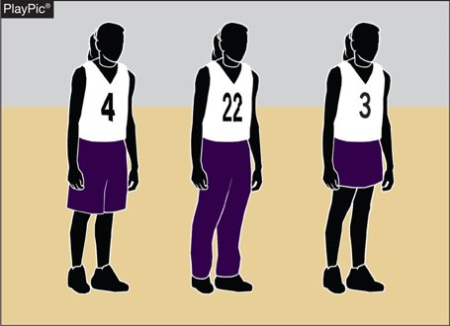
Uniforms, Equipment and apparel
Uniform bottoms do not have to match the torso of the uniform.
With the adoption of rule 3-4-5, uniform bottoms must be like-colored among teammates.
The bottom style may differ for every player, but the color must be the same.
Rolling and/or tucking of uniform bottoms is permissible, as long as the compression tights/sleeves, if worn, are color compliant.
Notes:
Uniform bottoms do not have to match the torso of the uniform.
With the adoption of rule 3-4-5, uniform bottoms must be like-colored among teammates.
The bottom style may differ for every player, but the color must be the same.
Rolling and/or tucking of uniform bottoms is permissible, as long as the compression tights/sleeves, if worn, are color compliant.

Slide 23
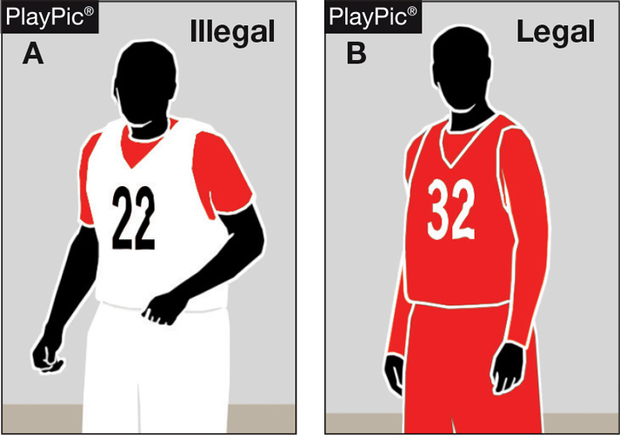
Uniforms, Equipment and apparel
Undershirts, if worn by the home team, shall be white, hemmed, not have frayed or ragged edges, and if they have sleeves, they shall be the same length.
Undershirts, if worn by the visiting team, must be a single solid color similar to the torso of the jersey or solid black and meet all other requirements as listed above. Team members may wear either the single solid color or black, but not both.
Notes:
Undershirts, if worn by the home team, shall be white, hemmed, not have frayed or ragged edges, and if they have sleeves, they shall be the same length.
Undershirts, if worn by the visiting team, must be a single solid color similar to the torso of the jersey or solid black and meet all other requirements as listed above. Team members may wear either the single solid color or black, but not both.

Slide 24
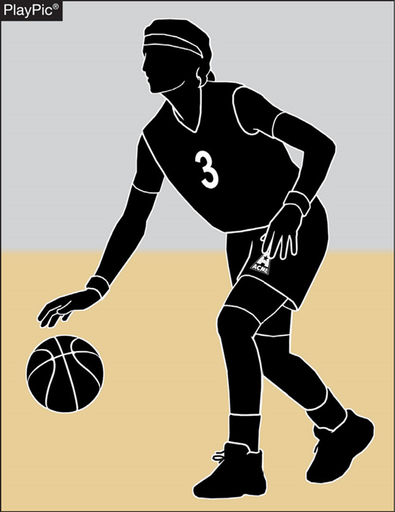
Uniforms, Equipment and apparel
Arm sleeves, knee sleeves, lower leg sleeves, compression shorts and tights are permissible.
Anything worn on the arm and/or leg is a sleeve, except a knee brace, and shall meet the color restrictions.
Sleeves/tights and compression shorts shall be black, white, beige or the predominant color of the jersey and the same color shall be worn by teammates.
All sleeves/tights and compression shorts shall be the same solid color and shall be the same color as any headband or wristband worn.
Notes:
Arm sleeves, knee sleeves, lower leg sleeves, compression shorts and tights are permissible.
Anything worn on the arm and/or leg is a sleeve, except a knee brace, and shall meet the color restrictions.
Sleeves/tights and compression shorts shall be black, white, beige or the predominant color of the jersey and the same color shall be worn by teammates.
All sleeves/tights and compression shorts shall be the same solid color and shall be the same color as any headband or wristband worn.

Slide 25
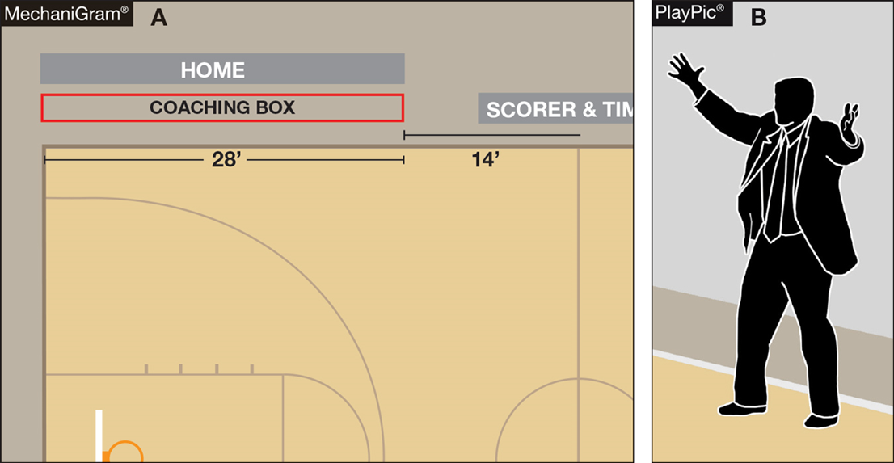
BENCH DECORUM
Through the enforcement of existing rules, coaches and bench personnel are expected to exhibit appropriate and acceptable behaviors.
Coaches are expected to remain in the coaching box.
Coaches who go beyond the 28-foot line, or more importantly onto the playing court, gain a distinct advantage that is not within the spirit or intent of the rules.
Notes:
Through the enforcement of existing rules, coaches and bench personnel are expected to exhibit appropriate and acceptable behaviors.
Coaches are expected to remain in the coaching box.
Coaches who go beyond the 28-foot line, or more importantly onto the playing court, gain a distinct advantage that is not within the spirit or intent of the rules.

Slide 26
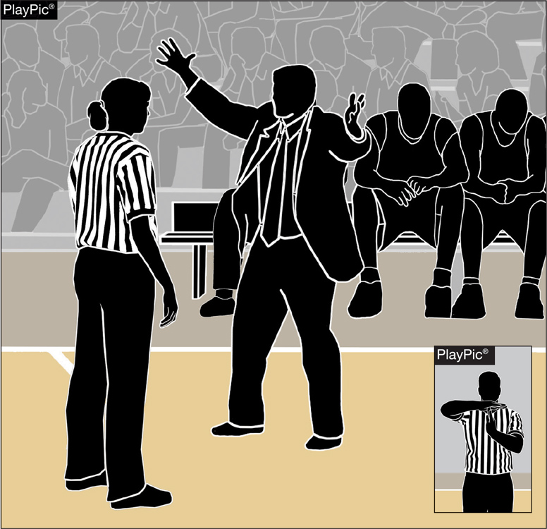
BENCH DECORUM
While the bench area expands during a time-out, the bench area does not extend beyond the 28-foot line.
Coaches and other bench personnel may not move to the extended bench area until the time-out begins to ensure bench personnel do not create inadvertent contact with opposing players still on the playing court.
Coaches who leave the expanded bench area to engage officials inappropriately are subject to a warning or bench technical foul.
Notes:
While the bench area expands during a time-out, the bench area does not extend beyond the 28-foot line.
Coaches and other bench personnel may not move to the extended bench area until the time-out begins to ensure bench personnel do not create inadvertent contact with opposing players still on the playing court.
Coaches who leave the expanded bench area to engage officials inappropriately are subject to a warning or bench technical foul.

Slide 27
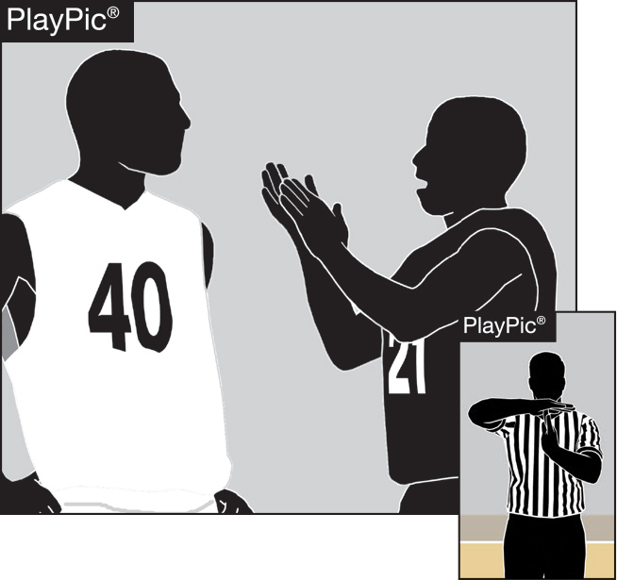
BENCH DECORUM
Misconduct, including taunting; baiting; finger-pointing; trash talking or using inappropriate gestures by players; coaches or bench personnel, is not permitted.
Players and coaches are not allowed to disrespectfully or inappropriately address and/or gesture at an official after a ruling is made on the court.
Player and coach behavior, which in the official’s judgment is determined to be a taunt of an opponent or a disrespectful act toward an official, shall be penalized by assessing a technical foul.
Notes:
Misconduct, including taunting; baiting; finger-pointing; trash talking or using inappropriate gestures by players; coaches or bench personnel, is not permitted.
Players and coaches are not allowed to disrespectfully or inappropriately address and/or gesture at an official after a ruling is made on the court.
Player and coach behavior, which in the official’s judgment is determined to be a taunt of an opponent or a disrespectful act toward an official, shall be penalized by assessing a technical foul.

Slide 28
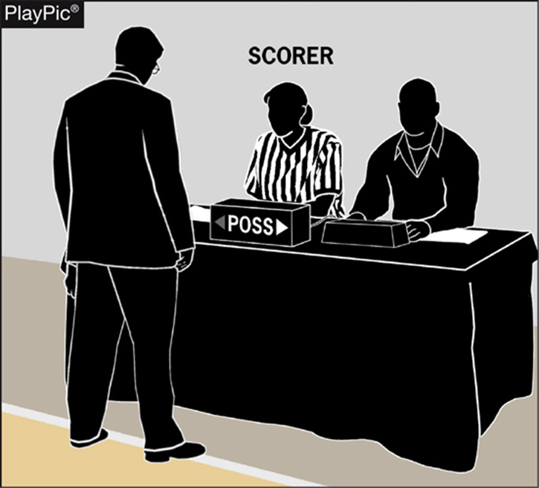
BENCH DECORUM
Assistant coaches are not authorized to approach the scorer’s table at any time.
The head coach is permitted to go to the scorer’s table to request a 60-second time-out to confer with personnel regarding a correctable error or to prevent or rectify a timing or scoring mistake/error or an alternating possession mistake.
Notes:
Assistant coaches are not authorized to approach the scorer’s table at any time.
The head coach is permitted to go to the scorer’s table to request a 60-second time-out to confer with personnel regarding a correctable error or to prevent or rectify a timing or scoring mistake/error or an alternating possession mistake.

Slide 29
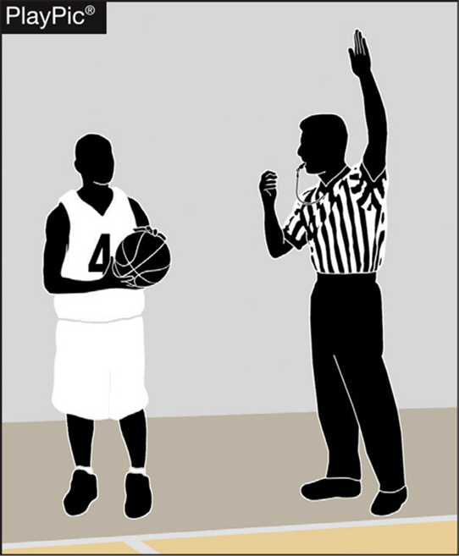
THROW-INS — PROPER LOCATIONS
Proper inbound spots contribute to the overall flow and fairness of the game.
Coaches design specific plays and strategies based on where the ball will be put in play.
It is therefore essential for game officials to be diligent in administering the ball at the proper throw-in location.
Any time a team causes the ball to go out of bounds, the throw-in occurs from the spot where the ball went out of bounds.
Notes:
Proper inbound spots contribute to the overall flow and fairness of the game.
Coaches design specific plays and strategies based on where the ball will be put in play.
It is therefore essential for game officials to be diligent in administering the ball at the proper throw-in location.
Any time a team causes the ball to go out of bounds, the throw-in occurs from the spot where the ball went out of bounds.

Slide 30
THROW-INS — PROPER LOCATIONS
When a violation, defensive foul before the bonus or dead ball (inadvertent whistle, held ball, etc.) occurs that will result in a throw-in, officials must ask themselves three questions:
Where did the violation/foul occur?
Is the throw-in team in their frontcourt or backcourt?
Where was the ball when the interruption occurred?
Notes:
When a violation, defensive foul before the bonus or dead ball (inadvertent whistle, held ball, etc.) occurs that will result in a throw-in, officials must ask themselves three questions:
Where did the violation/foul occur?
Is the throw-in team in their frontcourt or backcourt?
Where was the ball when the interruption occurred?

Slide 31
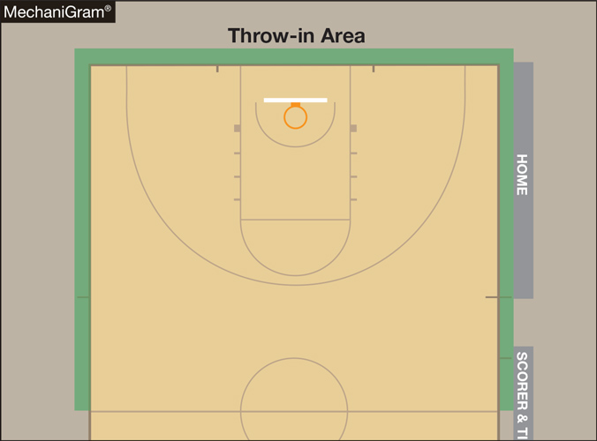
THROW-INS — PROPER LOCATIONS
When a team will gain or retain possession in its backcourt after a violation, foul prior to the bonus or stoppage in play, play will resume with a throw-in at either the point of interruption or the designated spot nearest to where the violation or foul occurred.
Notes:
When a team will gain or retain possession in its backcourt after a violation, foul prior to the bonus or stoppage in play, play will resume with a throw-in at either the point of interruption or the designated spot nearest to where the violation or foul occurred.

Slide 32
THROW-INS — PROPER LOCATIONS
When a team will gain or retain possession in its frontcourt, play will resume with a throw-in from one of the four designated frontcourt spots.
Notes:
When a team will gain or retain possession in its frontcourt, play will resume with a throw-in from one of the four designated frontcourt spots.

Slide 33
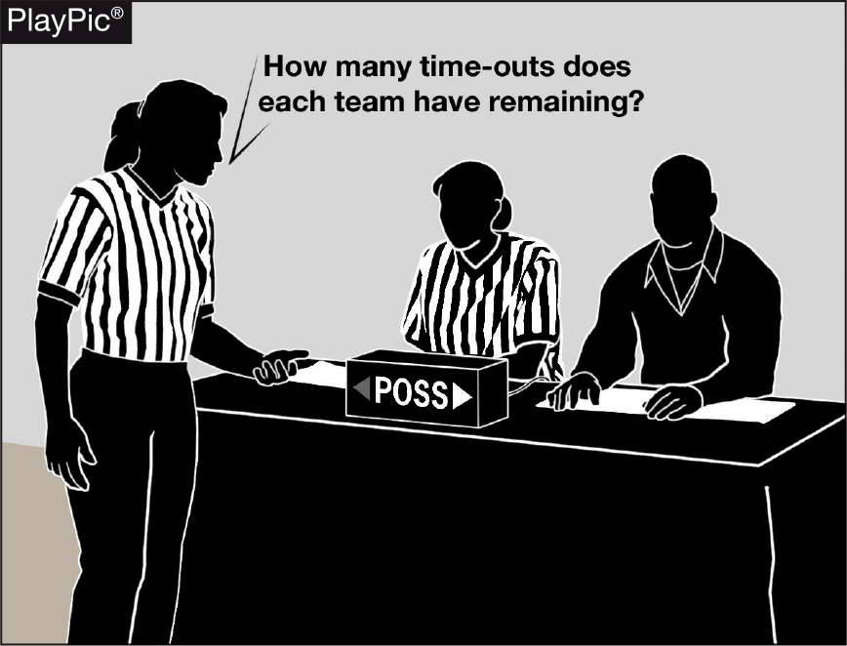
End-of-game protocols
As a game nears the end of playing time, officials need to remind each other of the game-ending procedures to prevent potential issues.
Late-game time-outs provide the best opportunities to:
Confirm scorebook accuracy with the scorer, the number of time-outs remaining for each team and the number of team fouls/impact on the bonus.
Remind the timer to watch officials for clock-start and clock-stop signals and be prepared to assist in aiding officials regarding whether a last-second shot was released prior to the end of time.
Notes:
As a game nears the end of playing time, officials need to remind each other of the game-ending procedures to prevent potential issues.
Late-game time-outs provide the best opportunities to:
Confirm scorebook accuracy with the scorer, the number of time-outs remaining for each team and the number of team fouls/impact on the bonus.
Remind the timer to watch officials for clock-start and clock-stop signals and be prepared to assist in aiding officials regarding whether a last-second shot was released prior to the end of time.

Slide 34
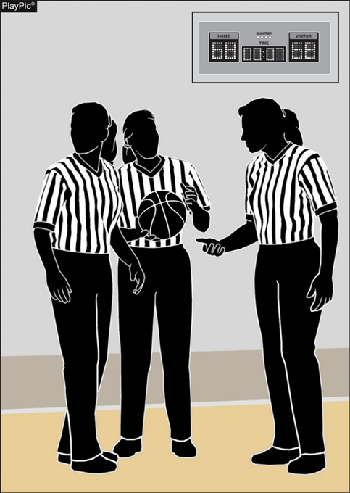
End-of-game protocols
During late-game time-outs the officials should discuss the following among the crew:
Last-second shot responsibility.
Unless the ball is tapped, no try can be attempted on a throw-in or free throw with .3 seconds or less remaining.
Intentional/flagrant fouls are two shots and a designated spot throw-in.
If a foul occurs as the game-ending horn sounds and the score can be tied or the game won by the ensuing free throws, the official must administer the free throws. If they will not change the outcome, they shall not be attempted.
Notes:
During late-game time-outs the officials should discuss the following among the crew:
Last-second shot responsibility.
Unless the ball is tapped, no try can be attempted on a throw-in or free throw with .3 seconds or less remaining.
Intentional/flagrant fouls are two shots and a designated spot throw-in.
If a foul occurs as the game-ending horn sounds and the score can be tied or the game won by the ensuing free throws, the official must administer the free throws. If they will not change the outcome, they shall not be attempted.

Slide 35
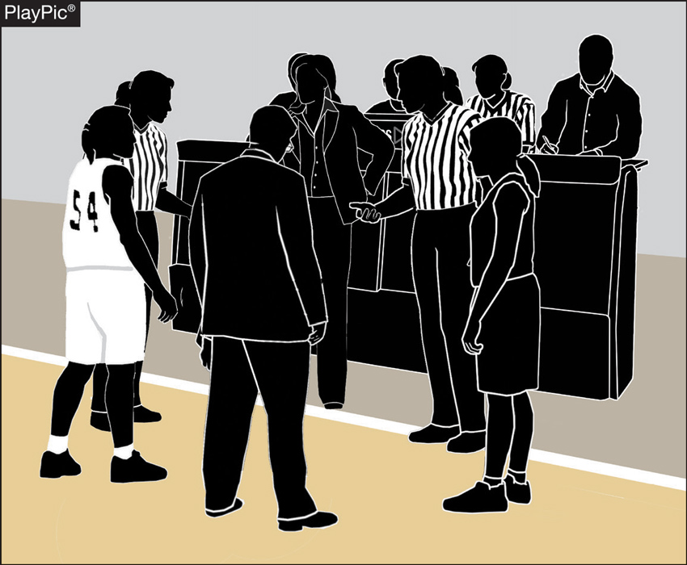
End-of-game protocols
If the score is tied at the end of regulation time, inform each team and the table officials of the overtime procedures (length of overtime period, additional 60-second time-out, etc.).
Notes:
If the score is tied at the end of regulation time, inform each team and the table officials of the overtime procedures (length of overtime period, additional 60-second time-out, etc.).

Slide 36
End-of-game protocols
Following the game-ending horn, the referee should confirm with the scorer that everything is correct, then leave the floor with their partner(s).
In situations when the score is separated by three points or less, it may be necessary to verbally confirm with the scorer.
In games when the margin of victory is larger, a visual signal such as a thumb’s-up will suffice.
Be confident everything is correct, as the officials’ jurisdiction ends when the entire crew leaves the visual confines of the playing court.
Notes:
Following the game-ending horn, the referee should confirm with the scorer that everything is correct, then leave the floor with their partner(s).
In situations when the score is separated by three points or less, it may be necessary to verbally confirm with the scorer.
In games when the margin of victory is larger, a visual signal such as a thumb’s-up will suffice.
Be confident everything is correct, as the officials’ jurisdiction ends when the entire crew leaves the visual confines of the playing court.

Slide 37
Thank You
National Federation of State High School Associations PO Box 690 | Indianapolis, IN 46206 Phone: 317-972-6900 | Fax: 317.822.5700 www.nfhs.org | www.nfhslearn.com | www.nfhsnetwork.com

